Slide 1
Engineering Design in a Mobile Makerspace
Connections Engineering Outreach, Faculty of Engineering and Applied Science
Desuree DeGagne and Scott Compeau
www.queensconnections.ca
@QEngConnections
Connections - Queen's Engineering Experience Program

Slide 2
Connections Engineering Outreach
Educational outreach program
Experiential opportunities for pre-university students to learn about engineering
Develop and share engineering-based educational activities that align with the Ontario curriculum
Support and professional development opportunities for educators

Slide 3
Connections Engineering Outreach
Notes:
We have this infographic printed for you as a resource – it is our goal to be diffusers of innovation, and we are hoping that after today’s session you will be able to incorporate engineering design in your classrooms.

Slide 4
What is Engineering Design?
Define
Brainstorm
Select
Prototype
Test
Iterate
Communicate
Identify
K-12 context

Slide 5
Engineering Design: Guiding Questions
Define
Identify
Brainstorm
Select
Prototype
Test
Iterate
Communicate
What is the problem we’re trying to solve?
What are the constraints on your solution? What are your criteria for success?
What are the possible solutions for the problem?
Choose the most promising solution.
Build your prototype.
Evaluate your prototype. Does it work?
Improve. Can we make it better?
Explain your solution.

Slide 6
Mobile Makerspace: Tech ‘n’ Tinker Trailer
Tour of Tech ‘n’ Tinker Trailer
https://goo.gl/Y271Ta
Notes:
This is our first school year with the TNT trailer. We are very proud to say that, in this time, we have worked with over 3000 students in the greater Kingston area (about an hour radius around Kingston). We have six PromoScience partner schools, and have had the opportunity to work with teachers and students from four school boards in our area. We have facilitated workshops for students in kindergarten to grade 8. The trailer provides students with the opportunity to engage with maker technologies, but it also acts a fresh start for every student; we have seen marginalized students take on leadership roles, and disengaged students actively participating.

Slide 7
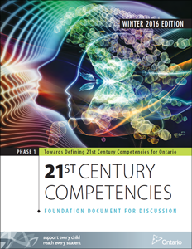
What does making look like in the TNT Trailer?
Through problem-based projects rooted in engineering design students…
Collaborate
Explore
Think critically
Think Creatively
Reflect
Take initiative
Communicate
Have fun!
Tools found in the TNT Trailer include:
Laptops (coding and designing)
3D printers
Makey Makeys
micro:bits
LittleBits

Slide 8
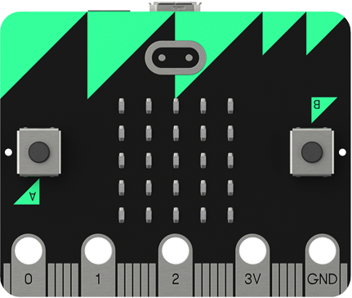
Engineering Design using micro:bit
Design challenge: wearable Rock, Paper, Scissors game (pg.1)
Your challenge is to design a wearable technology, incorporating the use of a micro:bit (micro-controller), to reimagine the time-honoured game of “Rock, Paper, Scissors”. To complete this task you will be using elastics, cardboard and other various materials to build a durable, cost-effective and environmentally friendly product.

Slide 9
Engineering Design using micro:bit
What is the problem we’re trying to solve?
Explain your solution.
Define
Brainstorm
Select
Prototype
Test
Iterate
Communicate
Identify
What are the constraints on your solution?
What are your criteria for success?
Improve. Can we make it better?
What are the possible solutions for the problem?
Wearable RPS
Choose the most promising solution.
Evaluate your prototype. Does it work?
Build your prototype.

Slide 10
Thank you and Questions?
www.queensconnection.ca
@QEngConnections
Connections - Queen's Engineering Experience Program

